Slide 1
Device Management using System Center Configuration Management
Dec 2018
M8
Microsoft 365 Device Series

Slide 2
Microsoft 365 A complete, intelligent solution that empowers everyone to be creative and work together, securely.
Unlocks creativity
Built for teamwork
Integrated for simplicity
Intelligent security
Notes:
Microsoft 365 is a complete, intelligent solution that empowers everyone to be creative and work together, securely. There are four main principles:
Unlocks creativity: First, Microsoft 365 inspires creativity, turning ideas into action with intelligent services & modern devices. For example, when you’re using PowerPoint, and see design recommendations pop up, or the way you can use a Surface pen to draw, powered by Windows.
Built for teamwork: Microsoft 365 also brings teams together, connecting people, data & insights with a universal toolkit for collaboration When I work with my team, as individuals or in groups, more often than not it’s on Skype. And Microsoft Teams is a hub for teamwork, with content and chat conversations all in one place.
Integrated for simplicity: Deep integration across Office 365, Windows 10 and EMS is delivered behind the scenes, resulting in a unified user experience. For example, Threat Intelligence is seamlessly integrated with Windows 10 Defender ATP, with reporting available in a single dashboard.
Intelligent security: And, of course, security is fundamental, with integrated, intelligent security that safeguards information, apps & identities with proactive response

Slide 3
Traditional Device Management using SCCM

Slide 4
Active Directory
Management
Existing supported versions are fully supported for Windows 10
New Group Policy templates are needed to support the new settings available for current release of Windows 10
Administrative Templates (.admx) for Windows 10 Fall Creators Update: https://www.microsoft.com/en-us/download/details.aspx?id=56121
No new Active Directory schema updates or specific functional levels are currently required for core Windows 10 product functionality, although subsequent upgrades could require these to support new features
Notes:
[Positioning]
For 1703 two new GPO security options has been updated and introduced
Interactive logon: Display user information when the session is locked
This security setting controls whether details such as email address or domain\username appear with the username on the sign-in screen
Interactive logon: Don't display username at sign-in
This security policy setting determines whether the username is displayed during sign in
Reference
https://technet.microsoft.com/en-au/itpro/windows/plan/windows-10-infrastructure-requirements#management-tools
https://technet.microsoft.com/en-us/itpro/windows/whats-new/whats-new-windows-10-version-1703#group-policy-security-options

Slide 5
Staying up-to-date with Configuration Manager
Importance
Aligning to the release cycle of Windows 10 and Microsoft Intune
Allows quick delivery of the important and management feature updates of Windows 10 and Intune
Each update version is supported for 12 months from its general availability (GA) release date. (Includes technical and security updates)
Leveraging in-console update for easy upgrade
Notes:
[Positioning]
The new System Center Configuration Manager, as it will simply be called, is designed to support the much faster pace of updates for Windows 10 and Microsoft Intune. This new version will also simplify the Configuration Manager upgrade experience itself, and allow us to listen and more quickly respond to your feedback.
We have taken your feedback on making Configuration Manager easier to update, and one of the core capabilities of this upcoming release is a brand new approach for updating the features and functionality of Configuration Manager. Moving faster with System Center Configuration Manager will allow you to take advantage of the very latest feature innovations in Windows 10, as well as other operating systems such as Apple iOS and Android when using Configuration Manager integrated with Microsoft Intune for mobile device management (MDM) and mobile application management (MAM) capabilities.
The fact that we are not including a calendar year in the name is a reflection of the fact that the new System Center Configuration Manager will be updated frequently.
Reference: https://blogs.technet.microsoft.com/enterprisemobility/2016/06/24/faq-system-center-configuration-manager-current-branch/

Slide 6
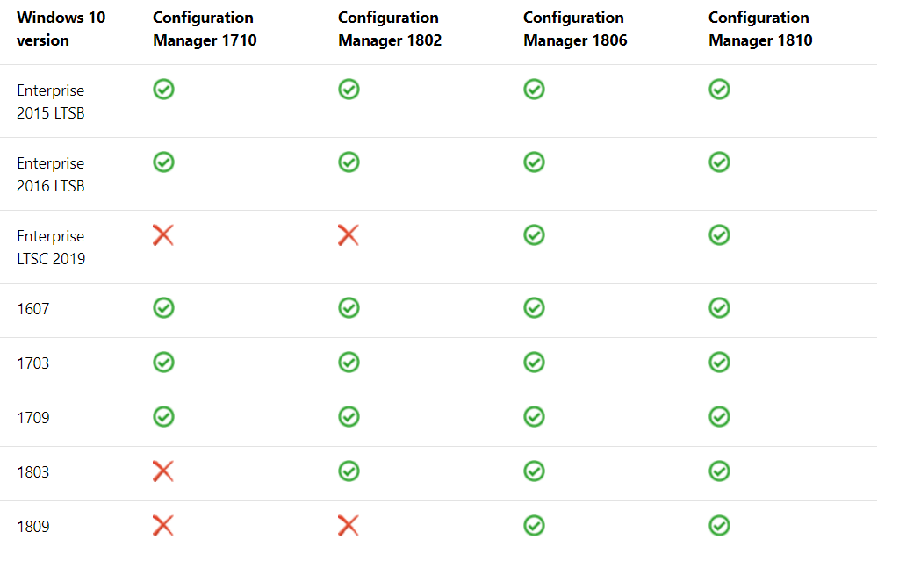
Support for Windows 10 as a client of SCCM
Notes:
[Positioning]
System Center Configuration Manager 1511 and 1602 has reached end of life and no longer supported.
BC - Backwards compatible - This means that existing client management features (hardware inventory, software inventory, software updates, etc.) should work with the new Windows 10 Current Branch build. Any known issues or caveats will be documented. This approach gives you the ability to deploy and manage new Windows 10 CB builds on day one with application compatibility support without requiring a new Configuration Manager update version.
[Reference]
https://docs.microsoft.com/en-us/sccm/core/plan-design/configs/support-for-windows-10

Slide 7
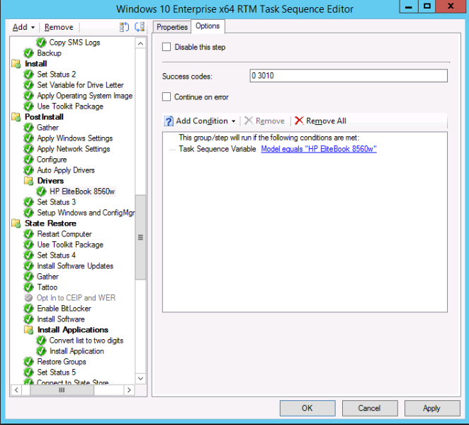
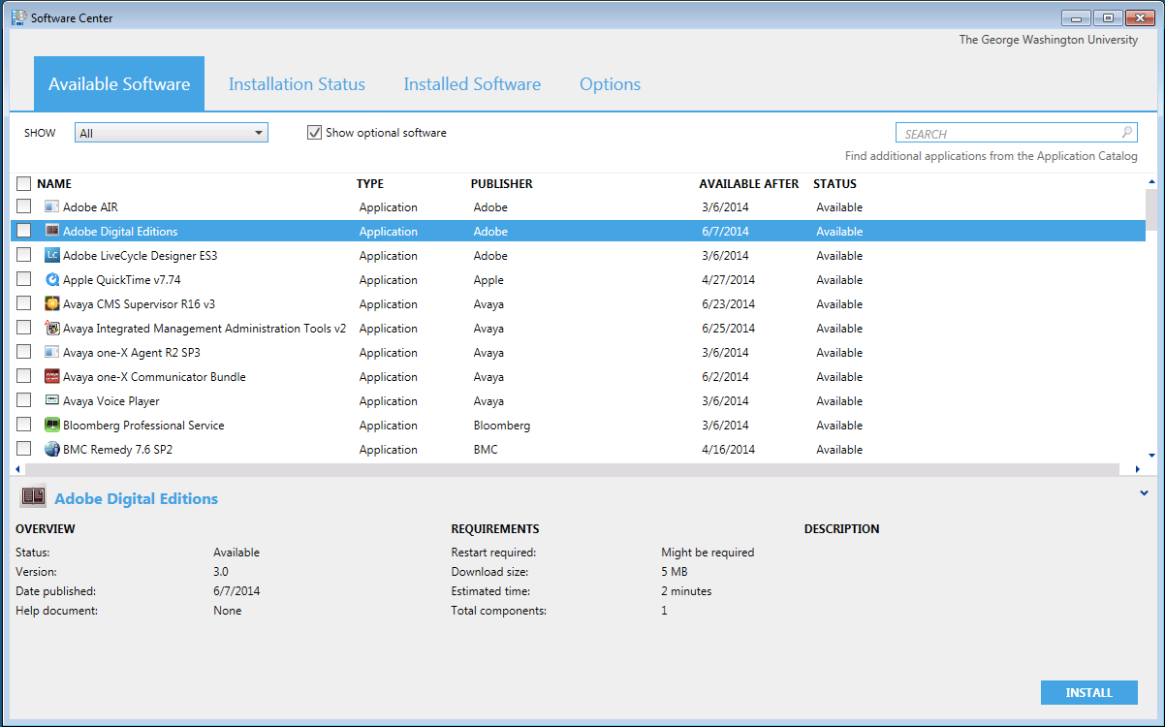
SCCM Task Sequence & Software Center
Overview
OSD Task Sequence: Provides mandatory application installation as part of imaging or Operating System deployment
Software Center: Provides self service application capability
New version, eliminates need for Application Catalog, provides ability to install device and user targeted applications
Previous version provides ability to install device targeted applications only
Usage Scenarios
Use OSD Task Sequence deployment for applications that are installed to all devices or for specific device models (laptop / desktop / tablet)
Use Software Center to make applications available to devices rather than users
Requirements
Previous version of Software Center available on System Center 2012 Configuration Manager SP2 and above. Supports up to Windows 10 version 1511.
New version of Software Center requires System Center Configuration Manager Current Branch. Supports Windows 10 Current Branch.
Software Center
OSD Task Sequence
Notes:
[Positioning]
Device Centric Application Deployment Options
Device and User Center Application Deployment options with new Software Center in System Center Configuration Manager 1511
ConfigMgr 2012 supports Windows 10 version 1507 (build 10.0.10240) and 1511 (build 10.0.10586) for the lifecycle of these builds. Any new Windows 10 CB/CBB builds released in the future will not be supported With ConfigMgr 2012 and will require System Center Configuration Manager current branch for supported management.
If you are deploying Windows 10 Current Branch, then you also need a plan to upgrade to System Center Configuration Manager. Once your environment is upgraded to System Center Configuration Manager, then you will be ready to start managing future builds of Windows 10 Current Branch as they are released.
Reference
https://technet.microsoft.com/en-us/library/mt595706.aspx
https://blogs.technet.microsoft.com/enterprisemobility/2015/10/27/system-center-configuration-manager-support-for-windows-10-and-microsoft-intune/

Slide 8
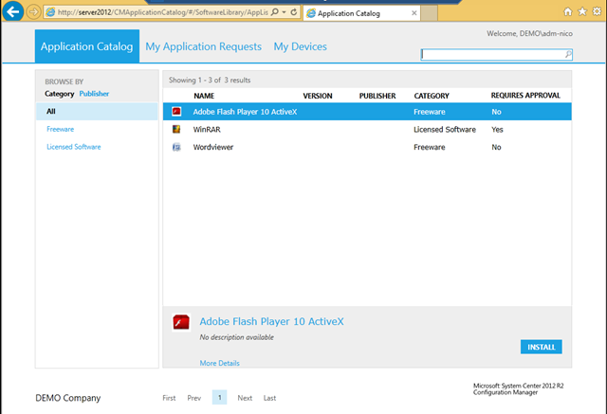
SCCM Application catalog & company portal
Overview
Application Catalog
Provide Self Service application deployment for available applications targeted at users.
New version of Software Center in System Center Configuration Manager Current Branch incorporates Application Catalog
Company Portal
Application that provides Self Service application deployment for available applications targeted at users. Requires application catalog infrastructure to be installed
Usage Scenarios
Create a consistent entry point and user experience to install available individual applications
Limited approval workflow is required in customer environment
Requirements
Application Catalog and Company Portal both require supporting System Center Configuration Manager infrastructure to operate
Company Portal also requires Company Portal application to be installed on Windows 10 devices
Application Catalog & Company Portal
Notes:
[Positioning]
User Centric Application Deployment Options
Reference
https://technet.microsoft.com/library/mt606938(v=vs.85).aspx

Slide 9
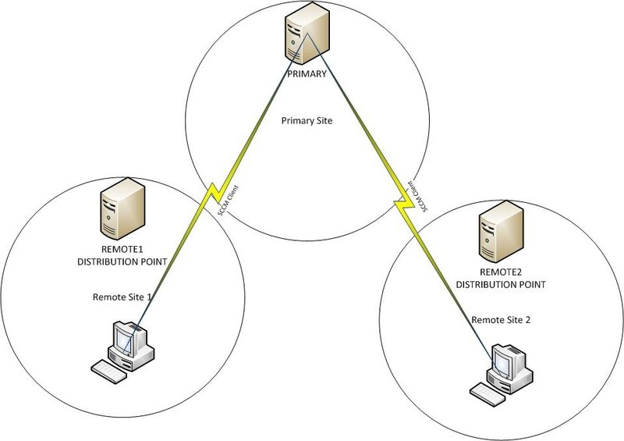
SCCM Software update point
Overview
System Center Configuration Manager capability to manage, deploy and monitor quality and feature updates
Quality Updates
Process unchanged from previous operating systems
Select Windows 10 product in administrative console to synchronize updates
Feature Updates
Windows 10 Servicing Node used to manage rings
Leverages Software Update Point functionality
Use When
System Center Configuration Manager is available
Notes:
[Positioning]

Slide 10
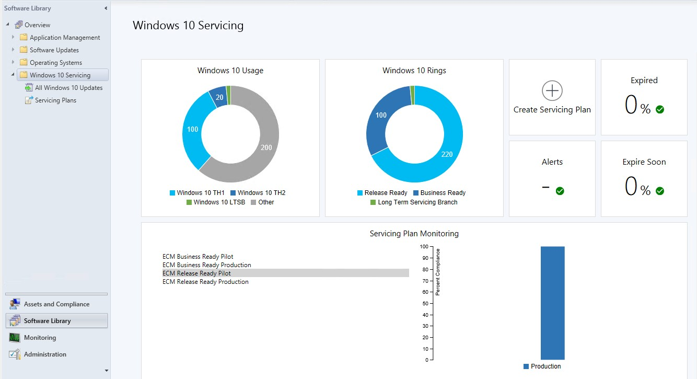
Implement with System Center Configuration Manager
Servicing
View the state of Windows 10 in the environment
Create a Windows 10 servicing plan
Deploy Windows 10 servicing content to devices
Notes:
[Positioning]

Slide 11
SCCM Application Management
Application Management
Support for Universal Windows Platform (UWP) apps for devices running Windows 10
Software Center has a new, modern look and apps that previously only appeared in the Application Catalog (user-available apps) now appear in Software Center under the Applications tab.
Ability to deploy Windows Installer (MSI) apps using Windows 10 Mobile Device Management (MDM)
Custom in-house iOS app only requires .ipa file (and .plist file no longer required)
When linking to an app in the Windows Store, you can browse the store directly from the Configuration Manager console
Notes:
[Positioning]
Although ‘application’ is a widely used term in computing, in Configuration Manager, it means something different. Think of an application like a box. This box contains one or more sets of installation files for a software package (known as a deployment type) plus instructions on how to deploy the software.
When the application is deployed to devices, requirements decide which deployment type is installed on the device.
In previous versions of Configuration Manager, Software Center was used to install and schedule software installations, configure remote control settings, and configure power management settings. Users could connect to the Application Catalog to browse for, and request software, configure some preference settings, and remotely wipe their mobile devices.
While these settings are still available in System Center Configuration Manager, a new version of Software Center is now available that allows you to browse for applications without having to use the Application Catalog, which requires a Silverlight enabled web browser. However the Application Catalog website point and Application Catalog web service point site system roles are still required for user-available apps to appear in Software Center.
Create and deploy an application with System Center Configuration Manager
https://docs.microsoft.com/en-us/sccm/apps/get-started/create-and-deploy-an-application

Slide 12
SCCM General Application Information
Application Information
Administrator information about applications (Read from Application Install file if present):
Manufacturer
Version
Administrative categories
Contact information for the application
Application Catalog information:
Information is displayed about application in localized language of user
Information consists of:
Localized application name
User categories
Documentation
Localized description
Notes:
[Positioning]
General application information provides general information about the application such as the name, description, version, owner, and administrative categories. Configuration Manager can read this information from the application installation files if it is present.
It provides information about how the application is displayed to users browsing the Application Catalog. You can configure information about the application to be displayed in a number of languages.

Slide 13
SCCM App Deployment
Supported Platfroms
Windows Applications
iOS Applications
Android Applications
Windows Phone Applications
Mac Computers Applications
Linux and UNIX Server Application
Windows Embedded Applications
Procedure
Select the Line-of-Business Application
Create the Application package
Add a requirement to the deployment type (e.g. Install only to Windows 10 PC)
Add the application content to a distribution point
Deploy the application as “Required” or “Available” to the selected Device or User Collection
Monitor the application deployment
Notes:
[Positioning]
Reference: https://docs.microsoft.com/en-us/sccm/apps/get-started/create-and-deploy-an-application

Slide 14
Labs
Lab 16 – Device Management & SCCM
https://m365.learnondemand.net/
Notes:
Refer to section 5.2 of the Lab Guide for the step by step guidance.

Slide 15
Thank You

